Slide 1
Lecture 2
History, Generation and Classification of Computers

Slide 2
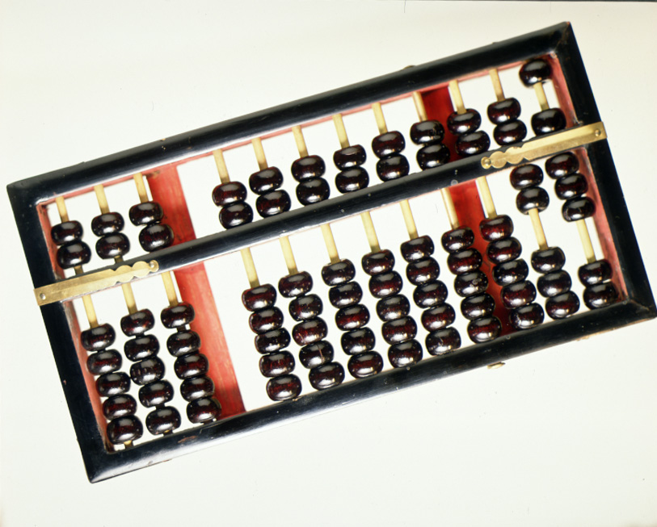
History Of Computing
Before the 1500, in Europe, calculations were made with an abacus
Invented around 500BC, available in many cultures (China, Mesopotamia, Japan, Greece, Rome, etc.)

Slide 3
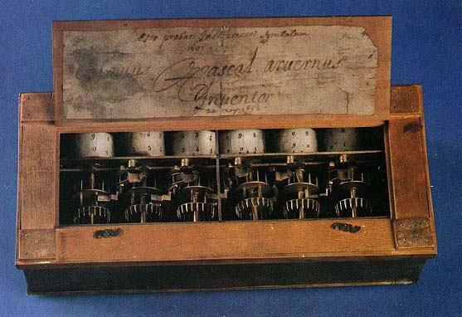
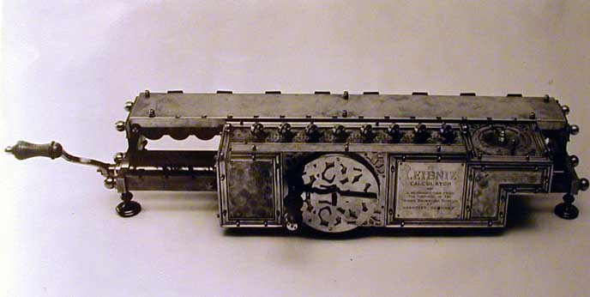
Pascaline
In 1642, Blaise Pascal (French mathematician, physicist, philosopher) invented a mechanical calculator called the Pascaline
In 1671, Gottfried von Leibniz (German mathematician, philosopher) extended the Pascaline to do multiplications, divisions, square roots: the Stepped Reckoner
None of these machines had memory, and they required human intervention at each step

Slide 4
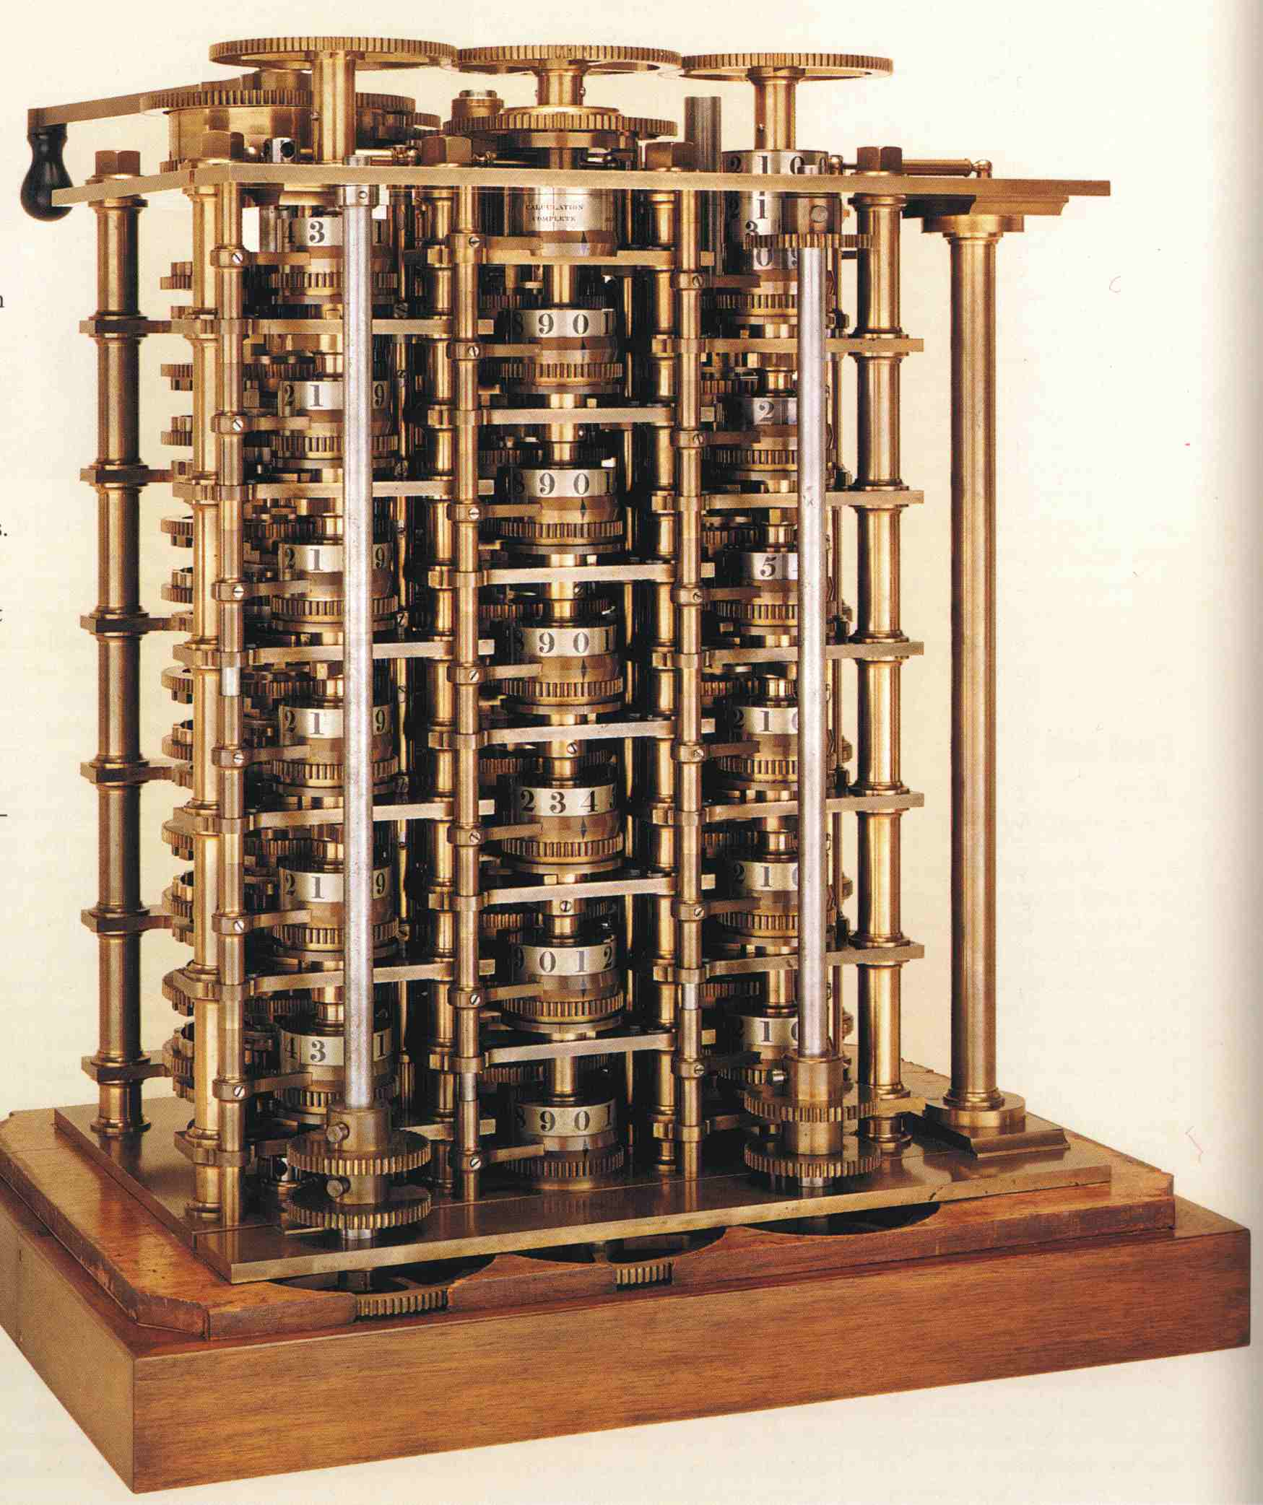
Difference Engine
In 1822 Charles Babbage (English mathematician, philosopher), sometimes called the “father of computing” built the Difference Engine
Machine designed to automate the computation (tabulation) of polynomial functions (which are known to be good approximations of many useful functions)
  Based on the “method of finite difference”
  Implements some storage

Slide 5
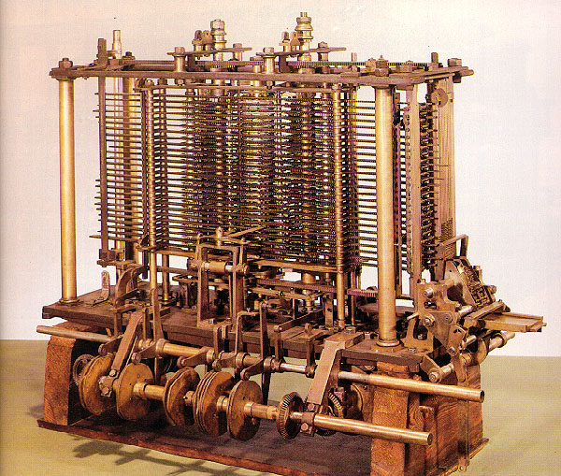
Analytical Engine
In 1833 Babbage designed the Analytical Engine, but he died before he could build it
  It was built after his death, powered by steam

Slide 6
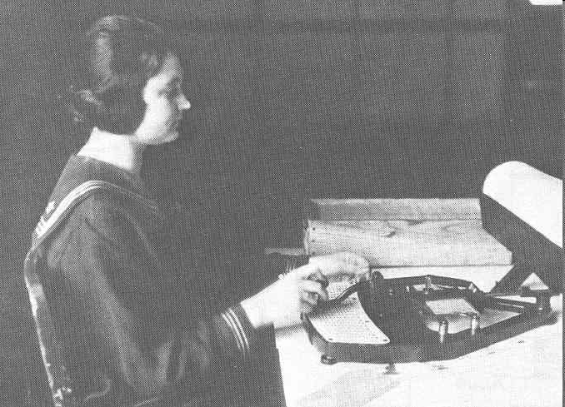
Punched Card Machine
Major development in 1886
The first chard machine which was electrically activated was used by Hollerith to compute the statistics of the 1890 US census.
Till 1960s the punched card system was the chief mode of processing data.

Slide 7
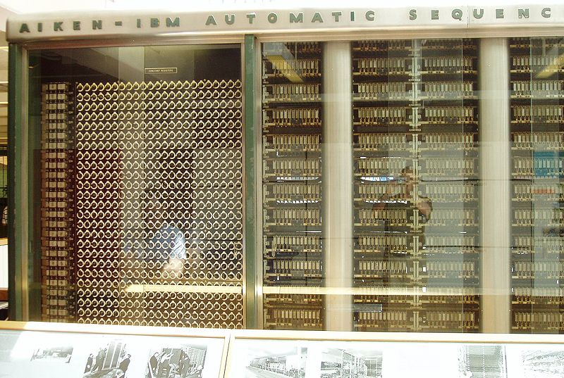
First Digital Computer
1937 H.A. Aiken of Harvard University began work on the design of fully automatic calculating machine
1944, the design became reality and name MARK I.
It could accept data from punch cards, store them in memory, make calculations
Could be programmed
Perform arithmetic and logical operations

Slide 8
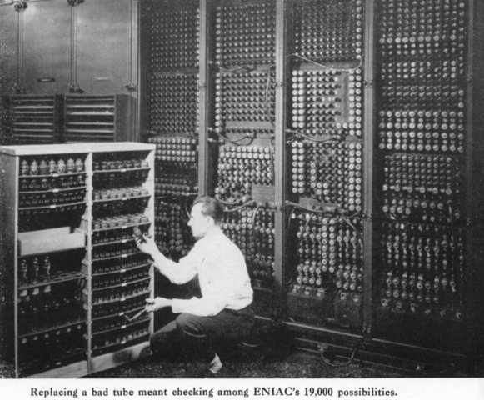
First Electronic Computer
ENIAC-Electronic Numerical Integrator and Calculator
It was introduced in 1947
Contains vacuum tubes, registers, capacitors and switches
Much faster than MARK I.

Slide 9
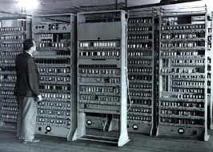
First computer to use Stored Program
EDSAC- Electronic Delayed Storage Automatic Computer
EDSAC first introduce stored program concept and was design and completed 1949 at Cambride University.
It used vacuum tubes and was little faster than the ENIAC.

Slide 10
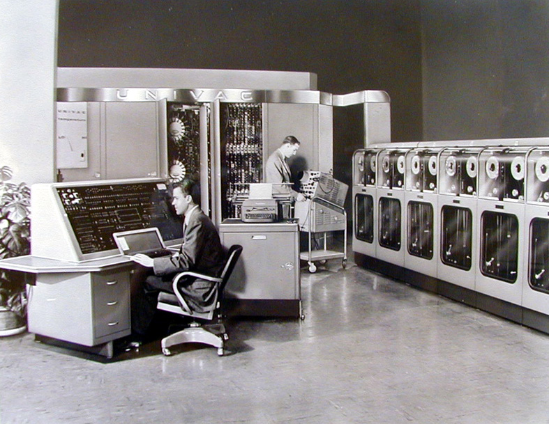
First Commercially Produce Computer
UNIVAC I – Universal Automatic Computer
Built in 1946
First installed at the US Bureau of Censor in 1951.
Could process numeric as well as alphabetic data.
Vacuum tubes were used
Magnetic tape for data input and output was first use here
After introducing transistor, size and cost reduced, speed increased.

Slide 11
Computer Generation
First Generation (1942-1955)
  The era of the vacuum tube
Second Generation (1956-1963)
  Transistor
Third Generation (1964-1971)
  Integrated Circuit
Fourth Generation (1971- present)
  Microprocessor
Fifth Generation (Present and Beyond)
  Artificial Intelligence

Slide 12
First Generation Computer
The first computers used vacuum tubes for circuitry and magnetic drums for memory, and were often enormous, taking up entire rooms.
A single drum can have up to 200 tracks. As the drum rotates at a speed of up to 3,000 rpm.
They were very expensive to operate and in addition to using a great deal of electricity, generated a lot of heat, which was often the cause of malfunctions.
Machine languages are the only languages understood by computers.

Slide 13
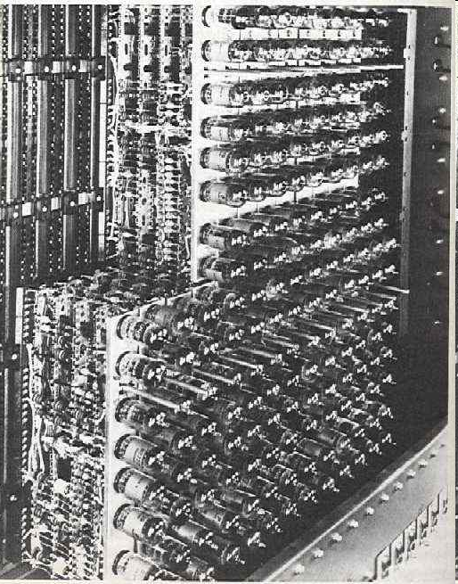
Continue..
Input was based on punch card and paper tapes, and output was displayed on printouts.
The UNIVAC and ENIAC computers are examples of first-generation computing devices.

Slide 14
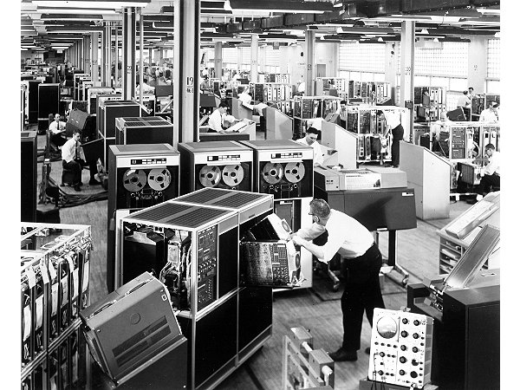
Second Generation Computer
Transistors replaced vacuum tubes.
computers to become smaller, faster, cheaper, more energy-efficient and more reliable than their first-generation predecessors.
computers still relied on punched cards for input and printouts for output.
Second-generation computers moved from cryptic binary machine language to symbolic, or assembly.
Example: IBM 1401, CDC 1604 .

Slide 15
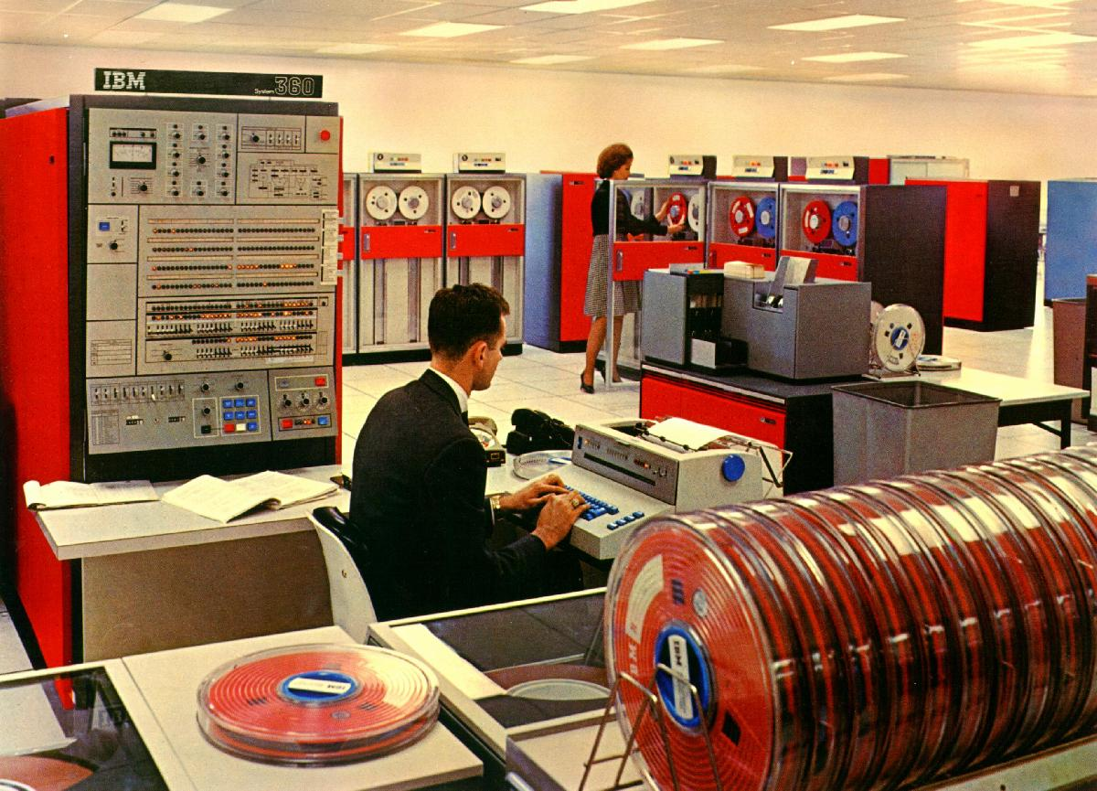
Third Generation Computer

Slide 16
Continue..
The development of the integrated circuit was the hallmark of the third generation of computers.
Computer chips, both for CPU and memory, are composed of semiconductor materials as IC.
Take less space, faster, less energy, cheaper
users interacted with computers through keyboards and monitors
Run more operation simultaneously
Ex: IBM 360, ICL 1900 series, Honeywell 600
Fortran IV, Cobol 68, PL/I used as language

Slide 17
Fourth Generation Computer
The microprocessor brought the fourth generation of computers.
Three basic characteristics differentiate microprocessors:
  Instruction Set: The set of instructions that the microprocessor can execute.
  Bandwidth: The number of bits processed in a single instruction.
  Clock Speed: the clock speed determines how many instructions per second the processor can execute.
The Intel 4004 chip, developed in 1971, first microprocessor

Slide 18
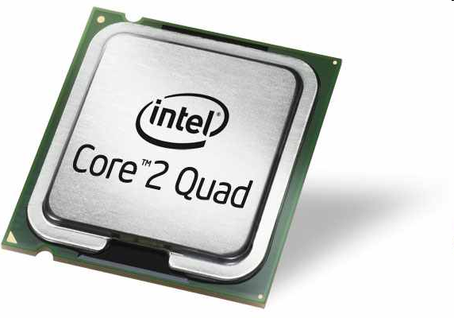
Continue…
In 1981 IBM introduced its first computer for the home user, and in 1984 Apple introduced the Macintosh.
Fourth generation computers also saw the development of GUI's, the mouse and handheld devices
very large scale integration, continued miniaturization, billions of circuits per cubic foot
Ex: IBM System 3090, IBM RISC 6000, HP 900

Slide 19
Fifth Generation Computer
Combinations of some or all of the following technologies:
-extremely large scale integration
-parallel processing
-high speed logic and memory chips
-high performance, micro-miniaturization
-voice/data integration; knowledge-based platforms
-artificial intelligence, expert systems
-virtual reality generation
-satellite links

Slide 20
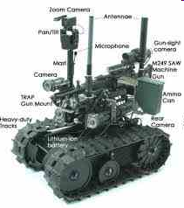
Continue…
Currently, no computers exhibit full artificial intelligence
In May,1997, an IBM super-computer called Deep Blue defeated world chess champion Gary Kasparov in a chess match.
AI language: LISP, prolog

Slide 21
Types of Computers
Computer
Analog
Digital
Hybrid
Special Purpose
General Purpose

Slide 22
Analog Computers
The word “Analog” means continuously varying in quantity.
An analog computer is a form of computer that uses the continuously-changeable aspects of physical phenomena
Electrical, mechanical, or hydraulic quantities to model the problem being solved. Like the voltage, current, sound, speed, temperature, pressure etc. values are examples of analog data.
The arithmetic functions performed by the computing units of analog machines are very complex.

Slide 23
Continue…
The analog computers have low memory size and have fewer functions.
These are very fast in processing but output return is not very accurate.
These are used in industrial units to control various processes and also used in different fields of engineering.
Analog computers are subject to electrical problems and limitations such as the noise floor of its signals, the finite nature of an electron's charge, microelectronic parasitic effects, temperature issues and non-linearities.

Slide 24
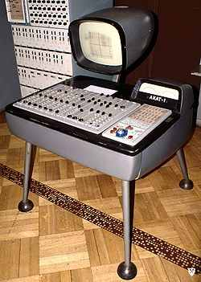
Continue…
Polish Analog computer AKAT-1

Slide 25
Digital Computers
The word “Digital” means discrete. It refers to binary system, which consists of only 2 digits, i.e., 0 and 1.
Digital data consists of binary data represented by OFF (low) and ON (high) electrical pulses. These pulses are increased and decreased in discontinuous form rather than in continuous form.
A computer that stores data in terms of digits (numbers) and proceeds in discrete steps from one state to the next.
In digital computers, even letters, words and whole texts are represented digitally.

Slide 26
Continue…
In digital computers, quantities are counted rather than measured. A digital computer operates by counting numbers or digits and gives output in digital form.
A digital computer represents the data in digital signals 0 and 1 and then processes it using arithmetic and logical operations.
Today most of the computers used in offices and homes are digital computers.
The main features of the computers are: accurate result production, high speed of data processing, large amount of data storage, easy of program and are general purpose in use, consume low energy.

Slide 27

Continue…
ENIAC: first successful electronic digital computer.

Slide 28
Hybrid Computers
The hybrid computers have best features of both analog and digital computers.
These computers contain both the digital and analog components.
In hybrid computers, the users can process both the continuous (analog) and discrete (digital) data.
These are special purpose computers.
These are very fast and accurate.
These are used in scientific fields.
In hospitals, these are used to watch patient’s health condition in ICU (Intensive Care Unit). These are also used in telemetry, spaceships, missiles etc.

Slide 29
Continue…
The digital component normally serves as the controller and provides logical operations, while the analog component normally serves as a solver of differential equations.
In general, analog computers are extraordinarily fast and Digital computers can be built to take the solution of equations to almost unlimited precision.
Hybrid computers can be used to obtain a very good but relatively imprecise 'seed' value, using an analog computer front-end, which is then fed into a digital computer iterative process to achieve the final desired degree of precision.

Slide 30
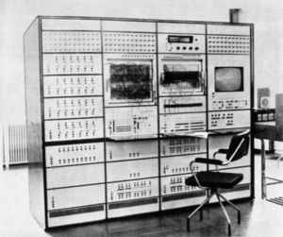
Continue…
Polish Hybrid computer WAT 1001

Slide 31
Types of Computers
Classification based on size:
  Microcomputers (Personal Computers)
  Minicomputers
  Mainframe computers
  Super computers

Slide 32
Microcomputers
A microcomputer is a computer with a microprocessor as its central processing unit.
Monitors, keyboards and other devices for input and output may be integrated or separate.
Computer memory in the form of RAM, and at least one other less volatile, memory storage device are usually combined with the CPU on a system bus in one unit.
It can only approximate a continuum by assigning large numbers of digits to a state description and by proceeding in arbitrarily small steps.

Slide 33
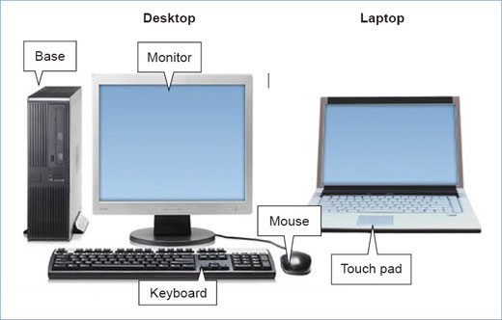
Continue…
Microcomputers

Slide 34
Minicomputers
A minicomputer (colloquially, mini) is a class of multi-user computers that lies in the middle range of the computing spectrum.
The term evolved in the 1960s to describe the "small" third generation computers that became possible with the use of integrated circuit and core memory technologies.
They had relatively high processing power and capacity that mostly fit the needs of mid range organizations.
The first successful minicomputer was Digital Equipment Corporation’s 12-bit PDP-8.

Slide 35
Continue…
They usually took up one or a few cabinets the size of a large refrigerator or two, compared with mainframes that would usually fill a room.
In the 70's they were the hardware that was used to launch the computer aided design, CAD, industry and other similar industries where a smaller dedicated system was needed.
Their abilities are defined by their single task computational speed (usually defined as MIPS — Millions of Instructions Per Second).

Slide 36
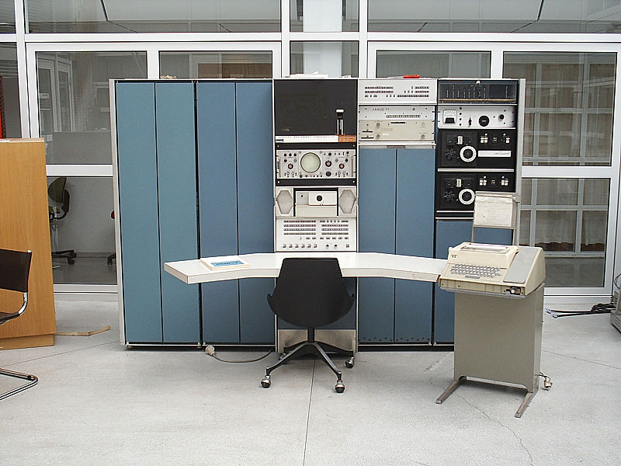
Continue…
Minicomputers (PDP 7)

Slide 37
Mainframe computers
Mainframes are powerful computers used mainly by large organizations for critical applications, typically bulk data processing such as census, industry and consumer statistics, enterprise resource planning, and financial transaction processing.
Mainframe computers have abilities defined by
- their redundant internal engineering and resulting high reliability and security,
- extensive input-output facilities,
- strict backward compatibility with older software, and
- high utilization rates to support massive throughput.

Slide 38
Continue…
Historically, mainframes acquired their name in part because of their substantial size, and because of requirements for specialized heating, ventilation, and air conditioning, and electrical power.
Nearly all mainframes have the ability to run (or host) multiple operating systems, and thereby operate not as a single computer but as a number of virtual machines.
In this role, a single mainframe can replace dozens or even hundreds of smaller servers.
Mainframes pioneered this virtualization capability with higher degree or level of sophistication.

Slide 39
Continue…
Historically, mainframes acquired their name in part because of their substantial size, and because of requirements for specialized heating, ventilation, and air conditioning, and electrical power.
Nearly all mainframes have the ability to run (or host) multiple operating systems, and thereby operate not as a single computer but as a number of virtual machines.
In this role, a single mainframe can replace dozens or even hundreds of smaller servers.
Mainframes pioneered this virtualization capability with higher degree or level of sophistication.

Slide 40
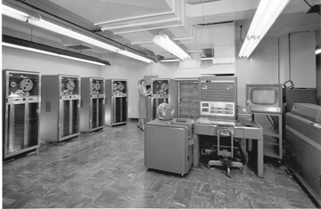
Continue…
Mainframe computers (IBM 704)

Slide 41
Super computers
A computer cluster is a collection of computers that are highly interconnected via a high-speed network or switching fabric. Each computer runs under a separate instance of an Operating System (OS).
A multiprocessing computer is a computer, operating under a single OS and using more than one CPU.
A SIMD processor executes the same instruction on more than one set of data at the same time.
Supercomputers consume and produce massive amounts of data in a very short period of time.

Slide 42
Continue…
Technologies developed for supercomputers include:
  Vector processing
  Liquid cooling
  Non-Uniform Memory Access (NUMA)
  Striped disks (the first instance called RAID)
  Parallel file-systems
Examples of special-purpose supercomputers:
  Belle, Deep Blue, and Hydra: for playing chess
  GRAPE, for astrophysics and molecular dynamics
  Deep Crack, for breaking the DES cipher
  MDGRAPE-3, for protein structure computation

Slide 43
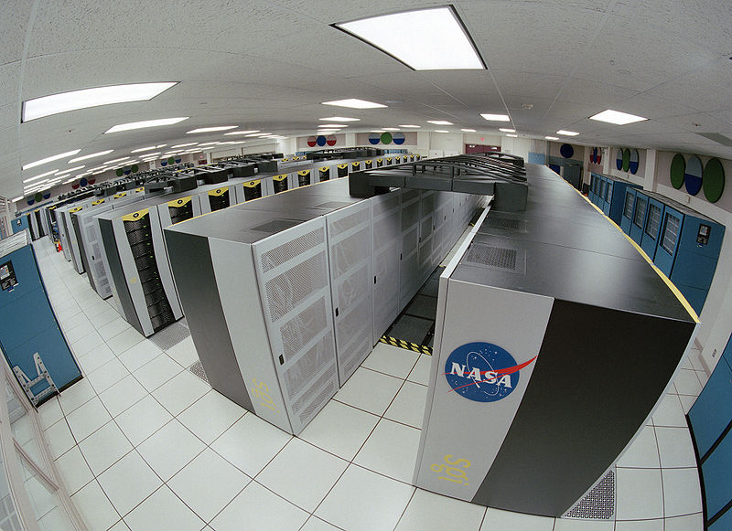
Continue…
Super computer (Columbia)

Slide 44
Thank You!

